Slide 1









My Linear Equations Interactive Notebook
$$×$$
$$\frac{1}{2}$$
$$÷$$
$$+$$
$$−$$
$$\frac{3}{5}$$
$$7$$
Name
Class
Teacher
Term 1 Semester 1
$$5^{2}$$
$$\sqrt{9}$$
1

Slide 2
Contents
Glossary or Formula Page
Page
Date
Description
2
3

Slide 3
Tasks
24
7
30
Essential Question
Questions
Notes
Summary
6
7

Slide 4
24
7
30
Date
Inequalities
EQ – How do I look at something greater than or less than?
7

Slide 5
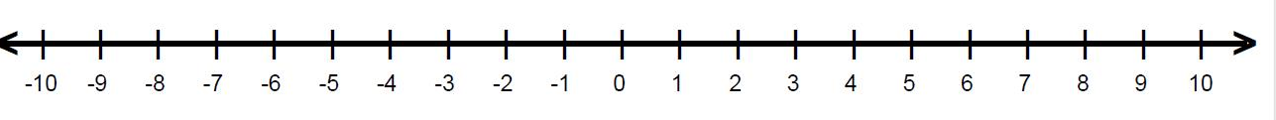
24
7
30
Date
Inequalities
EQ – How do I look at something greater than or less than?
Inequalities can be, greater than, less than, greater than or equal to or less than or equal to. The equal to has a filled in circle the non equal part has a hollow circle.
greater than or less than
Eg x < 2 See below or x > 4
What if I there is greater than and equal to or less than and equal to
.
Eg x ≤ -2 or x ≥ 5
greater than and equal to or less than and equal to
7

Slide 6
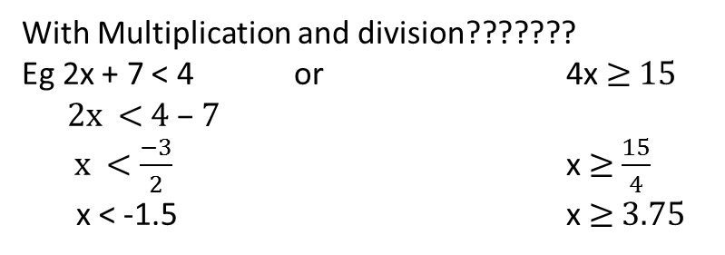
24
7
30
Date
Inequalities
EQ – How do I look at something greater than or less than?
What if I have to solve an equation first – with addition and subtraction it is the same as normal.
Eg x + 5 < 3 or x -7 > -2
x < 3 – 5 x > -2 + 7
x < -2 x > 5
With Multiplication and division???????
Eg 2x + 7 < 4 or 4x ≥ 15
2x < 4 – 7
x < $\frac{−3}{2}$ x ≥ $\frac{15}{4}$
x < -1.5 x ≥ 3.75
7

Slide 7
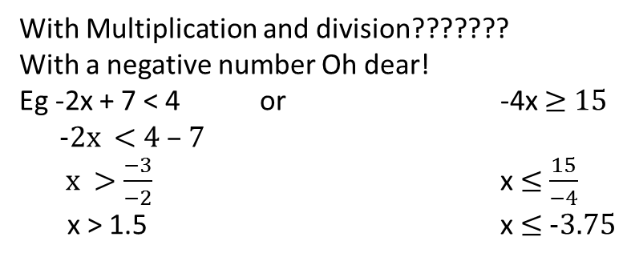
24
7
30
Date
Inequalities
EQ – How do I look at something greater than or less than?
With Multiplication and division???????
With a negative number Oh dear!
Eg -2x + 7 < 4 or -4x ≥ 15
-2x < 4 – 7
x > $\frac{−3}{−2}$ x ≤ $\frac{15}{−4}$
x > 1.5 x ≤ -3.75
< becomes >
> becomes <
≤ becomes ≥
≥ becomes ≤
If you multiply or divide both sides of an inequation
by a negative.
then
7

Slide 8
Exercises
Exercise 2.3 and 2.4 from Dwyer
All to be done with a smile on your faces.

Slide 9
Notes Review
24, 7 ,30
Date
Title
Essential question
Notes complete
Notes complete with colour and diagrams
Questions completed
Contents page filed in
Formula page filled in

Slide 10
Homework
Review your notes and write a summary answering the essential question.

